Slide 1
The Neutralizer
Knowledge and the Web, 25/1/2019
Daudier Chloé
DeHaven Robbert
Luqman Elias
Tran Tuan-Anh

Slide 2
TABLE OF CONTENTS
Introduction
Method
Architecture
Data
Reference mapper
Anaphora-coreference resolution
Summarizer
ClaimBuster filter
Topical similarity
Grouping similar sentences
Results
Conclusion
Further work

Slide 3
1- Introduction
Goal of the Neutralizer
To educate the user on a given news subject
How to achieve this?
Show the references for the news articles, visually
Display relationship between articles and their references
May identify common sources between different articles
A method to find more articles in the same news subject
Provide a spectrum of views from a variety of news sources
Generate summaries for different news articles
General summaries
Factcheck-worthy summaries
Highlight topically similar sentences in different summaries
Do sentences agree with or contradict each other?
Display results in a UI-friendly format

Slide 4
2- Method
Collect data
Select news subject and identify articles from a variety of sources
Extract urls (i.e. references) from each news article
Display graph of relationship between articles and their references
Extract text, title, url etc. from each article
Summarize each article
Run summaries through ClaimBuster filter to generate factcheck-worthy summaries
Create topical similarity matrix for all sentences in a news subject
Create topical groupings
Pipeline 1: reference mapper
Pipeline 2: summary comparison

Slide 5
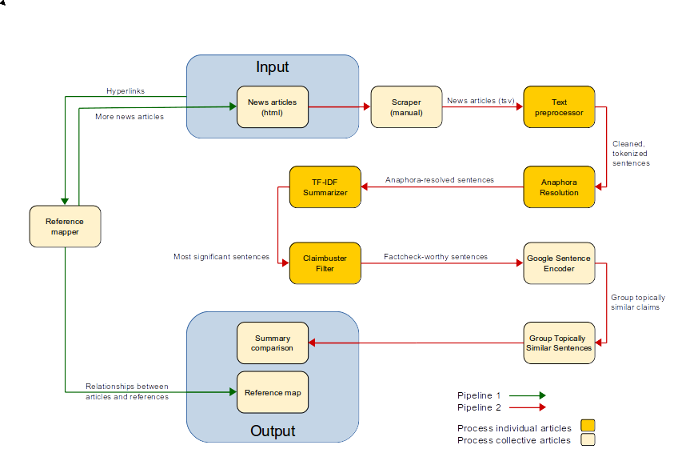
3- Architecture

Slide 6
4- Data
Data sources
From mostly US news sites
Handpicked ±10 news articles in 3 controversial news subjects
News sources:
Left: BuzzFeed News, Vox, Huffington Post, Slate, Daily Kos, The Washington Post etc.
Center: NPR, BBC News, New York Times, ABC News, The Hill, Bloomberg etc.
Right: New York Post, Breitbart, Fox News etc.
Data scraping
Manual scraping

Slide 7
4- Reference mapper
What is reference mapping?
Why is this mapping useful?
Article 3
Article 1
Source 1
Source 2
Article 2
Easily view the most cited sources
Show clusters that cite the same source (and possibly have the same view on the news subject)
Indicate possible lack of sources
Help identify new articles we can potentially add to dataset

Slide 8
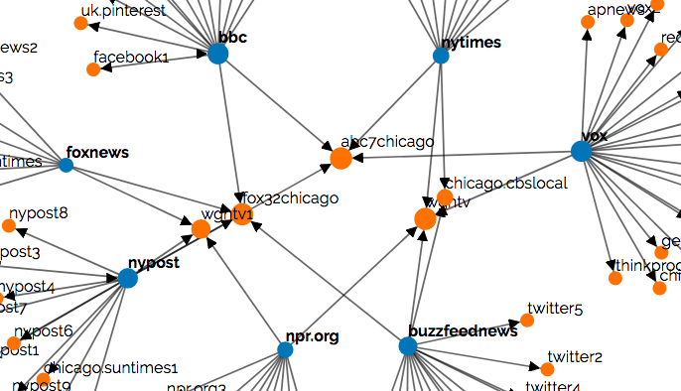
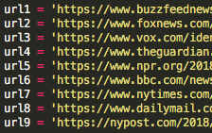
4- Reference mapper
Implementation details
Select ±10 news articles for the given subject from a range of sources
Extract and filter urls from the html of each article
Create dictionaries for nodes and links
Display graph
Python
D3js, html, CSS
URLs
Json
Map
graph = {
nodes : [
{ … },
{ … }],
Links : [
{ … },
{ … }]
}

Slide 9
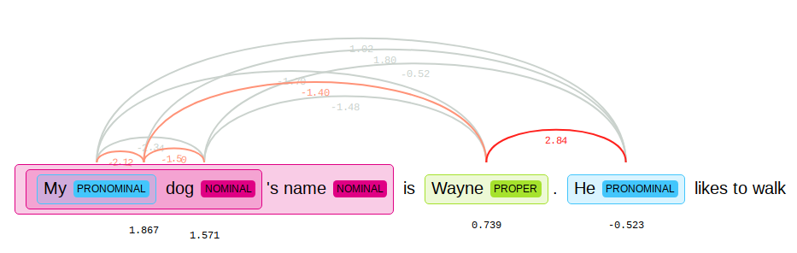
5- Anaphora-coreference resolution
Resolve anaphora
Improves readability in summaries
Example:
Implementation details
Neuralcoref library by Huggingface
Neural network model

Slide 10
6- Summarizer: option 1 (TF-IDF)
TF-IDF (term frequency - inverse document frequency)
Popular term weighting scheme
Measures how relevant a term is to a particular document
Background corpus: NLTK Reuters corpus (subset)
Sentence score: sum of TF-IDF scores for every word
Optimizations
Stopword-filtering
Only nouns and verbs scored
Sentences related to title given a score bonus
Other possible tweaks:
Stem/lemmatize terms
Apply positional weights
Implementation details
Generate top-5 and top-10 sentence summaries
Sentence ordering: document order
Scikit-learn (TF-IDF)
NLTK (stopword-filtering, POS tagging, Reuters corpus)

Slide 11
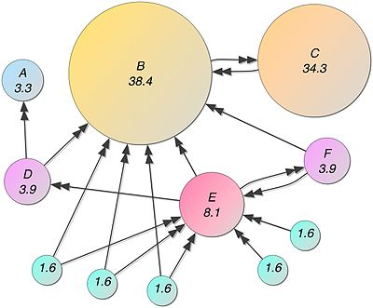
6- Summarizer: option 2 (TextRank)
PageRank
Measuring the importance of website pages
TextRank
Consider sentences the equivalent of web pages
The probability of going from sentence A to sentence B is equal to the similarity of the 2 sentences
Apply the PageRank algorithm over this sentence graph
Implementation details
Pytextrank library

Slide 12
6- TF-IDF and TextRank comparison
TF-IDF summary
An armed security guard at a bar in suburban Chicago was killed by police as he detained a suspected gunman, according to officials and witnesses.
After gunfire erupted around 04:00 local time on Sunday, Jemel Roberson, 26, chased down an attacker and knelt on his back until police arrived.
Moments after police came on the scene, an officer opened fire on Roberson, who was black, killing him.
Sophia Ansari, a spokeswoman for the Cook County Sheriff's office, said police were called to the scene after a fight broke out in the bar and four people were shot.
"How in the world does the security guard get shot by police?"
TextRank summary
An armed security guard at a bar in suburban Chicago was killed by police as he detained a suspected gunman, according to officials and witnesses.
Moments after police came on the scene, an officer opened fire on Roberson, who was black, killing him.
Friends say Roberson was a musician who had dreams of joining the police.
"Just waiting on the police to get there.”
Illinois State Police's Public Integrity Taskforce have been asked to investigate the shooting, Ms Ansari told the BBC.

Slide 13
7- ClaimBuster filter
Factcheck-worthy filter
Examples of sentences that are not factcheck-worthy
Implementation details
ClaimBuster scores sentences by how factcheck-worthy they are
Scoring is done on a scale of 0.0 to 1.0 (the higher the score, the more likely the sentence is to contain factcheck-worthy claims)
Scores are not context sensitive
“Here is what we know so far about the attack, the suspect and the victims.”
“Reports said Cecil Rosenthal liked to greet people at the door of the synagogue before services.”
“Jonathan Greenblatt, chief executive officer of the Anti-Defamation League, said the group believes Saturday's attack was the deadliest on the Jewish community in US history.”
“As news of the recount broke, Trump weighed in on Twitter.”
Queried ClaimBuster API
Threshold of 0.3 used
Notes:
Given a sentence, ClaimBuster gives it a score between 0.0 and 1.0. The higher the score, the more likely the sentence contains check-worthy factual claims. The lower the score, the more non-factual, subjective and opinionated the sentence is.

Slide 14
8- Topical similarity: option 1 (SIF)
SIF (Smooth Inverse Frequency)
Based on word embeddings
Weighted average of word embeddings used
Word weight = a/(a + p(w))
(where a is a parameter that is set to 0.001 and p(w) is the frequency of the word from a reference corpus)
Removes bias from words that are semantically irrelevant
Implementation details
Gensim (Word2Vec embeddings)
Scikit-learn (cosine similarity)
NLTK (stopword-filtering)

Slide 15
8- Topical similarity: option 2 (Google USE)
Google USE (Universal Sentence Encoder)
Pre-trained deep averaging network (DAN) model
Can used for semantic similarity and text classification tasks
Optimized for “greater-than-word length text, such as sentences, phrases, or short paragraphs”
Advantages over SIF:
Supervised model
Takes word order into account
Models embeddings beyond the level of individual words
Implementation details
Google USE model (1GB)
Tensorflow

Slide 16
8- SIF and Google USE comparison
Sentence 1 | Sentence 2 | SIF similarity score | USE similarity score
Roberson played music at the Purposed Church in Chicago for the past several years, according to Pastor LeAundre Hill, who tweeted that Roberson "had just played for my grandma's funeral Friday and now he's gone." | Roberson was working to "enough money together for a deposit on a new apartment", said Hunter, the great uncle of Laquan McDonald, a black teenager fatally shot in 2014 by a white Chicago police officer. | 0.26 | 0.43
Four other people were shot and wounded during the incident, including a man who police believe fired a gun before police arrived, the Cook county sheriff's spokeswoman, Sophia Ansari, said. | Four others were shot and wounded, including a man who police believe fired a gun before police arrived, Cook County sheriff's spokeswoman Sophia Ansari said. | 0.89 | 0.98
A police officer fatally shot an armed security guard who witnesses say was trying to detain a man following a shooting at a suburban Chicago bar, authorities said. | An armed security guard at a bar in suburban Chicago was killed by police as he detained a suspected gunman, according to officials and witnesses. | 0.58 | 0.94

Slide 17
8- Semantic similarity vs stance similarity
Semantic similarity --> topical similarity
Original goal to implement stance detection using semantic similarity methods
Not sufficient, so adapted semantic similarity methods to measure topical similarity
Sentence 1 | Sentence 2 | Semantic similarity score
Let’s go home | Let’s go home | 1.00
Should we get going | Should we go | 0.81
I like strawberries | I do like strawberries | 0.97
I do like strawberries | I do not like strawberries | 0.95
I like strawberries | Let’s have strawberries | 0.83

Slide 18
9- Grouping similar sentences
Manual selection
Sentence 1 | Sentence 2 | Semantic similarity score
A | B | 1.00
A | C | 0.81
A | D | 0.97
B | C | 0.95
B | D | 0.83
Select sentences with similarity scores of at least THRESHOLD = 0.9

Slide 19
9- Grouping similar sentences
Similarity matrix
Distance matrix
A | 1
B | 0.84 | 1
C | 0.53 | 0.63 | 1
D | 0.28 | 0.37 | 0.60 | 1
E | 0.23 | 0.35 | 0.70 | 0.69 | 1
 | A | B | C | D | E
A | 0
B | 0.16 | 0
C | 0.47 | 0.37 | 0
D | 0.72 | 0.57 | 0.40 | 0
E | 0.77 | 0.65 | 0.30 | 0.31 | 0
 | A | B | C | D | E
Clustering methods for distance matrix:
K-Medoids
Hierarchical Clustering

Slide 20
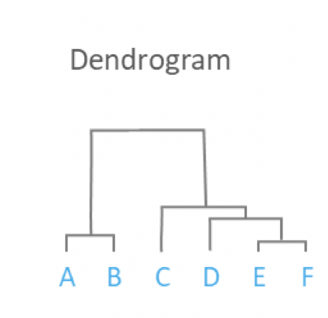
9- Grouping similar sentences
For example: With THRESHOLD = 0.8 (similarity), we can get 2 groups (A, B) and (E, F)

Slide 21
10- Results
Demo

Slide 22
10- Results
Demo
ClaimBuster filtering
Significant majority of sentences in that made it into summaries are factcheck-worthy claims
News Subject | Average number of sentences filtered out by ClaimBuster per summary
 | Top-5 summary | Top-10 summary
Accidental shooting | 0.33 | 1.44
Florida midterm elections | 0.00 | 1.11
Synogogue shooting | 0.25 | 1.28

Slide 23
11- Conclusions
Views fairly consistent between news articles
Somewhat surprising given that we picked articles from sources across the political spectrum on what we thought were controversial subjects
Even questionable sources generate accurate news sometimes. How does the user know when they’re being misinformed? One of the major problems with fake news?
Larger dataset needed for more testing
May discover problems we didn’t find with our limited dataset
May also better showcase the abilities of the Neutralizer e.g. display conflicting views from different sources
Viable proof-of-concept
User is exposed to a variety of views on a given news subject
User can see how the articles are related to their references and possibly each other in a visually clear manner

Slide 24
12- Further Work
Data
Collect larger dataset (more new subjects, more articles per news subject)
Automate finding news articles
Automate scraping (newspaper library from MIT)
Use related news articles found by reference mapper to expand dataset
Perform stance detection
Summarizer tweaks
Identity consistent and conflicting views automatically
Stem/lemmatize terms
Apply positional weights
Notes:
More data allows us to do more thorough testing. May find more interesting patterns in output.

Slide 25
Thank you for your attention!
Questions?

